Slide 1
X-section W-X
See Cross section locations.kmz & Cross section labels.kmz for location in Google Earth

Slide 2
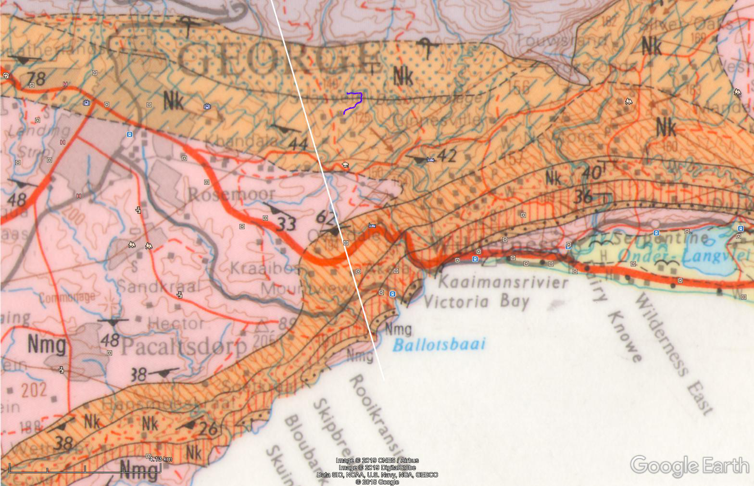
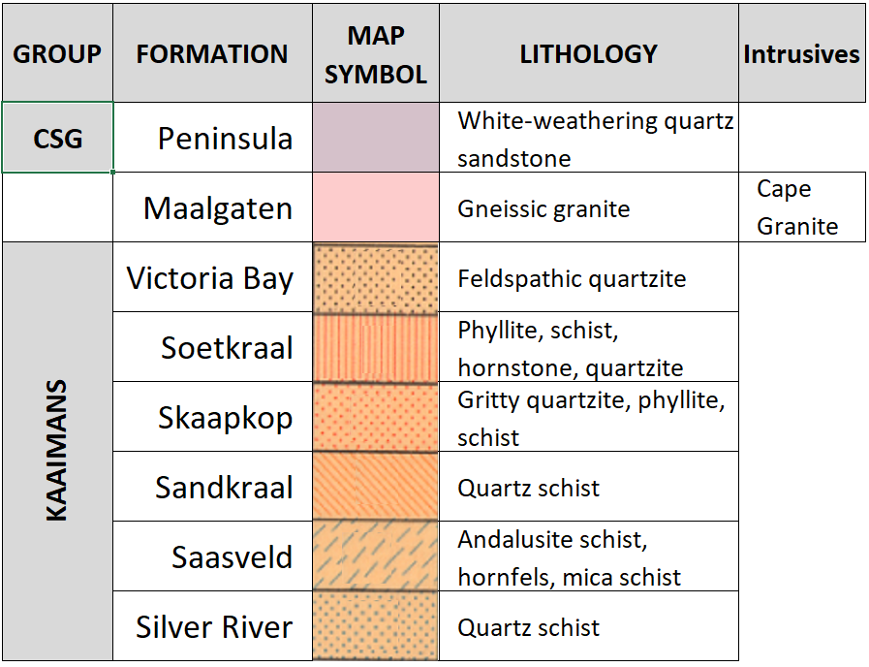
W
Peninsula
Andalusite
Silver River
Woodville Pluton
Saasveld
Sandkraal
Skaapkop
Victoria Bay
Soetkraal
George Pluton
gneissic granite
X

Slide 3
Schematic Geologic Cross Section W-X
Showing the contact metamorphic setting of the phyllitic andalusite schist exposed in the Kaaimans River near the start of the Groeneweide Trails
W
X
Andalusite
N2
Ballots Bay
Sea level
Silver River
Peninsula Formation
Sandkraal
Soetkraal
Victoria Bay
Skaapkop
Unconformity
Saasveld
Maalgaten granite
George Pluton

Slide 4
